Slide 1
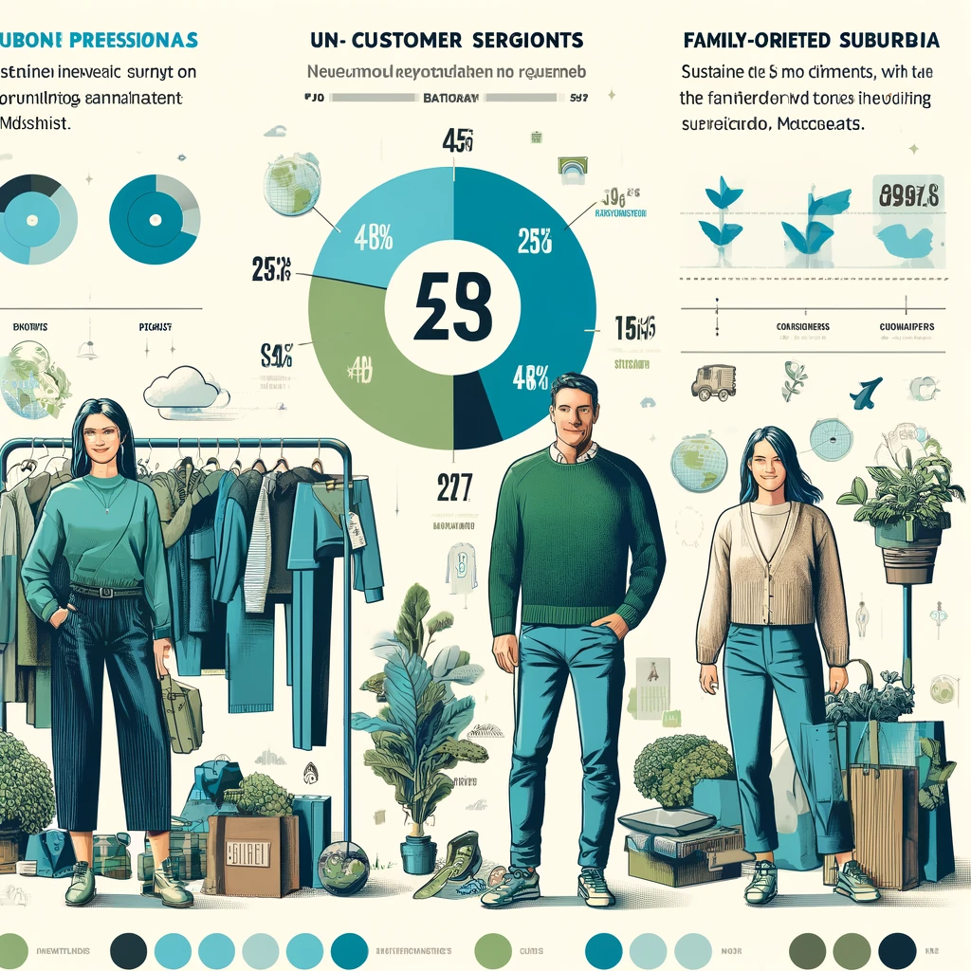
Understanding the Needs of Our Customers
Customer Segments:
Urban Professionals
Suburban residents aged 25- 45
Unmet Needs:
Finding sustainable fashion easily
Affordability, Transparency, and Convenience
User Insights:
Buyers: 60% of buyers want to allocate 40% of their wardrobe to eco-friendly options but are open to increasing this number
Sellers: Affordability and lack of constant demand for Sustainability in Wardrobe has been an issue
Spring 2024

Slide 2

EcoThreads: Sustainable Fashion Marketplace - Proposed Solution
Curated Platform Connecting Buyers with Sellers
Offers
Guaranteed Sustainable Materials
Convenience of Online Shopping
Transparent and Engaging Experience
Positioned as Accessible Option with focus on
Community Building
Affordable Fashion
Spring 2024

Slide 3
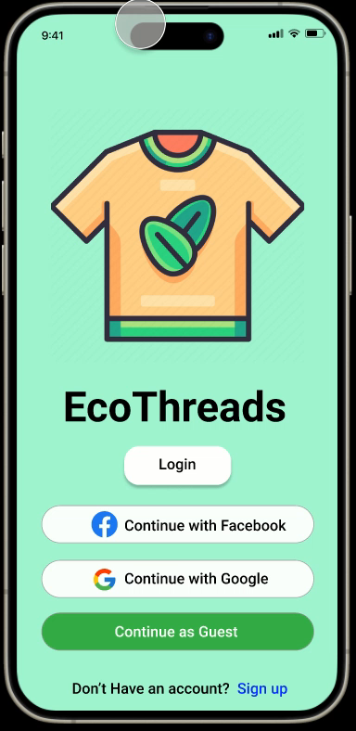
Visual Storyboarding - A complete walkthrough of Product Features

Slide 4
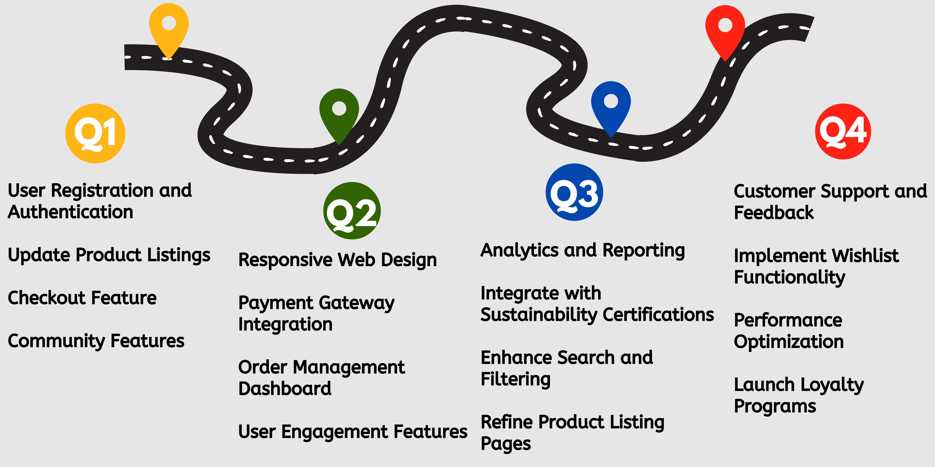
Product Roadmap
Spring 2024

Slide 5
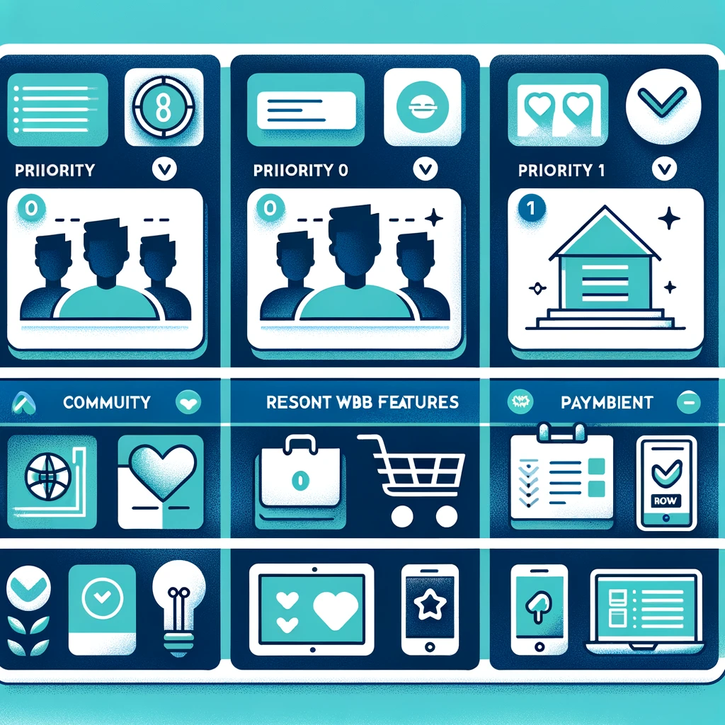


Features of MVP for Launch
Priority 0
User Registration and Authentication.
Product Listings with basic filtering.
Simple Checkout process.
Priority 1
Community Features
Responsive Web Design
Payment Gateway Integration
Priority 2
Analytics and Reporting
Integrate with Sustainability Certifications
Customer Support and Feedback
Spring 2024

Slide 6
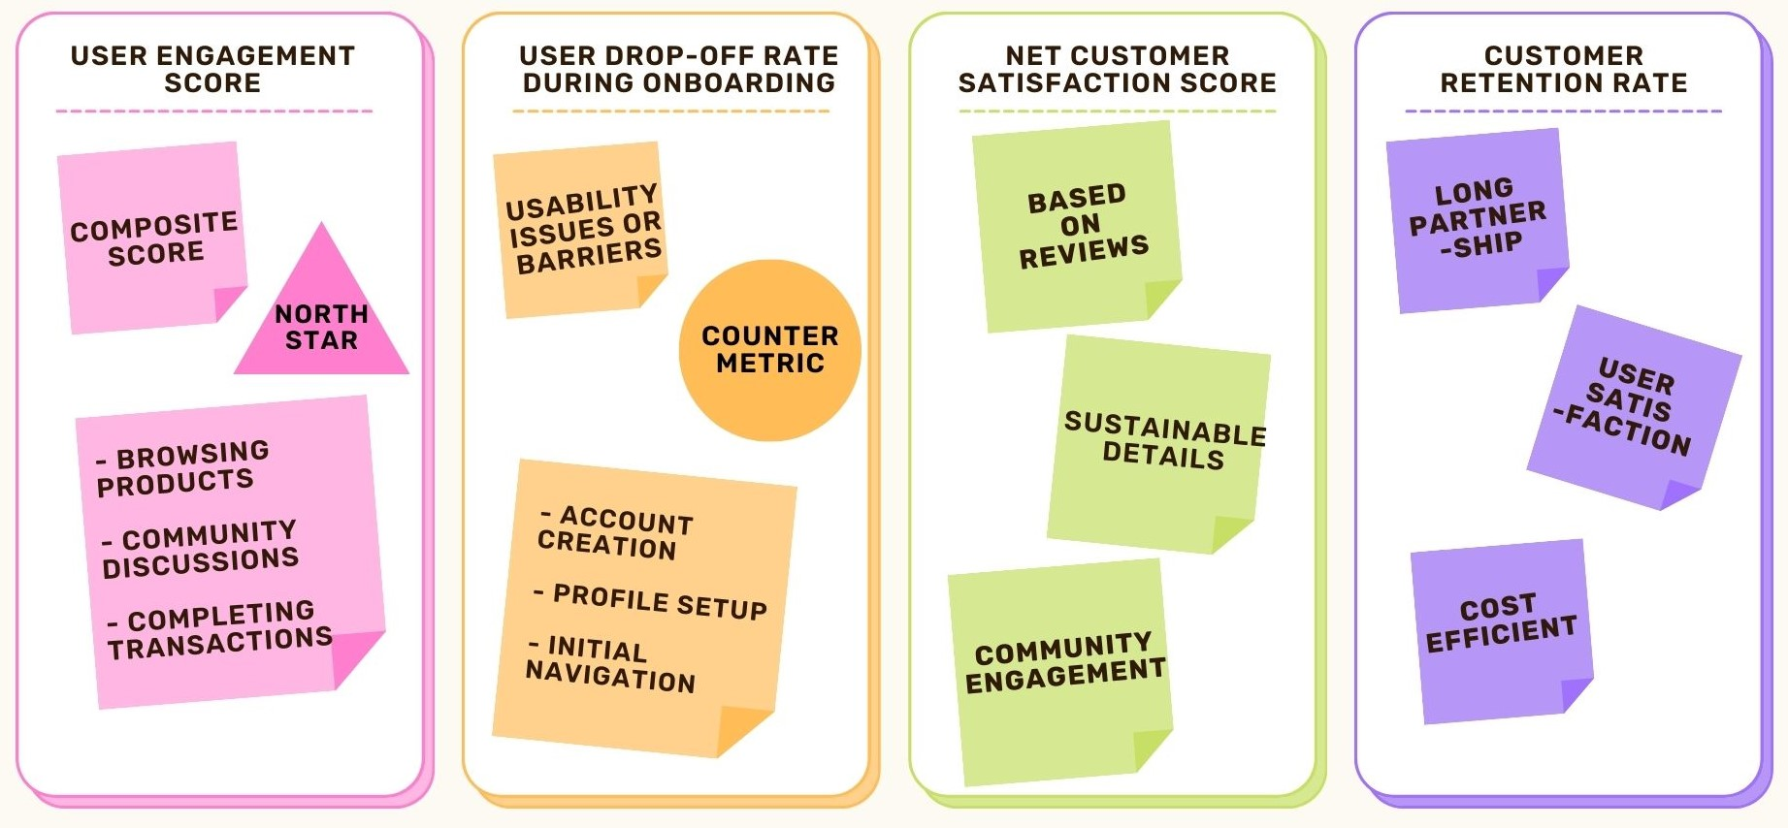
Performance Metrics to Watch -Key Metrics

Slide 7
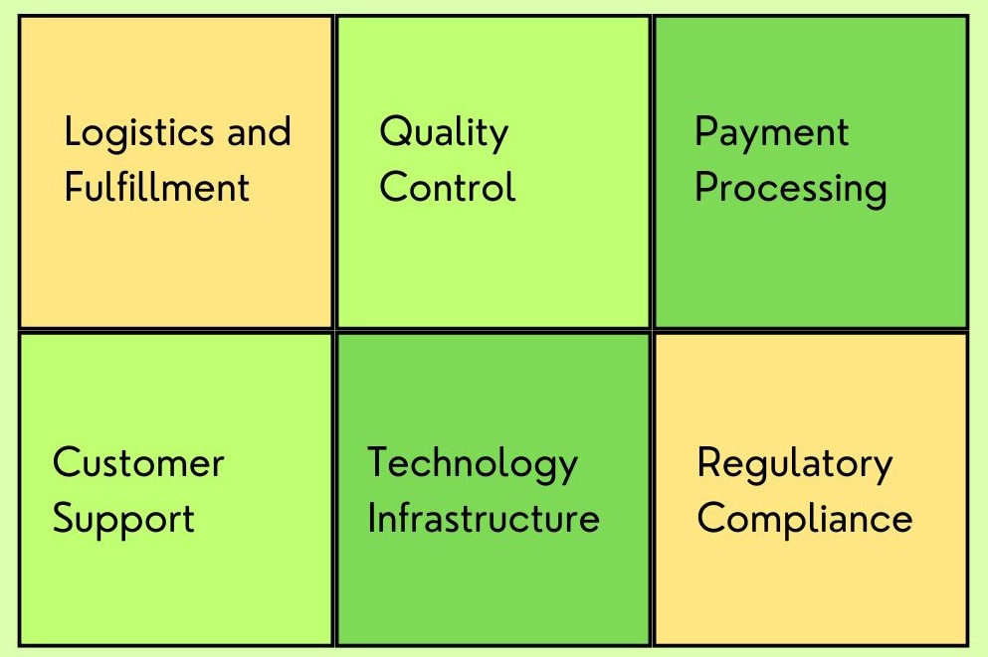
Operational Needs

Slide 8
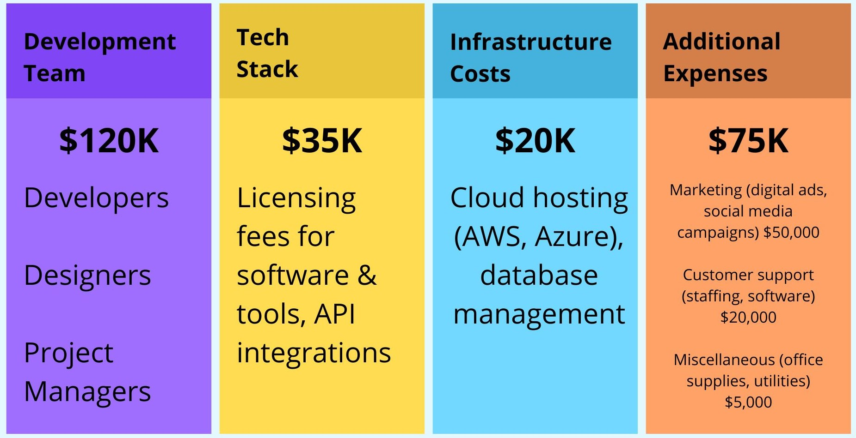
Projected Costs $250K
Spring 2024

Slide 9

Addressing Risks
Supplier Reliability: Diversify, monitor, communicate, audit
Regulatory Compliance: Set up regulatory department, update policies, educate
Legal/Patent Risks: Strong agreements, Consult Experts, monitor the products
Spring 2024

